Slide 1

Model Driven SW-Development for Embedded Systems with Eclipse eTrice Thomas Schütz Protos Software GmbH
Eclipse Demo Camp Beijing, June 29, 2013

Slide 2
The Eclipse etrice Project
etrice provides an implementation of the ROOM modeling language (Realtime Object Oriented Modeling)
official Eclipse Foundation Open Source project
codegenerators and runtime for Java, C and C++
based on industrial proven standard technologies (Eclipse, EMF, Xtext, Graphiti, ...)
guiding principles
extensibility
conceptual integrity
simplicity
etrice is a Modeling Toolset for eventdriven, concurrent realtime systems

Slide 3
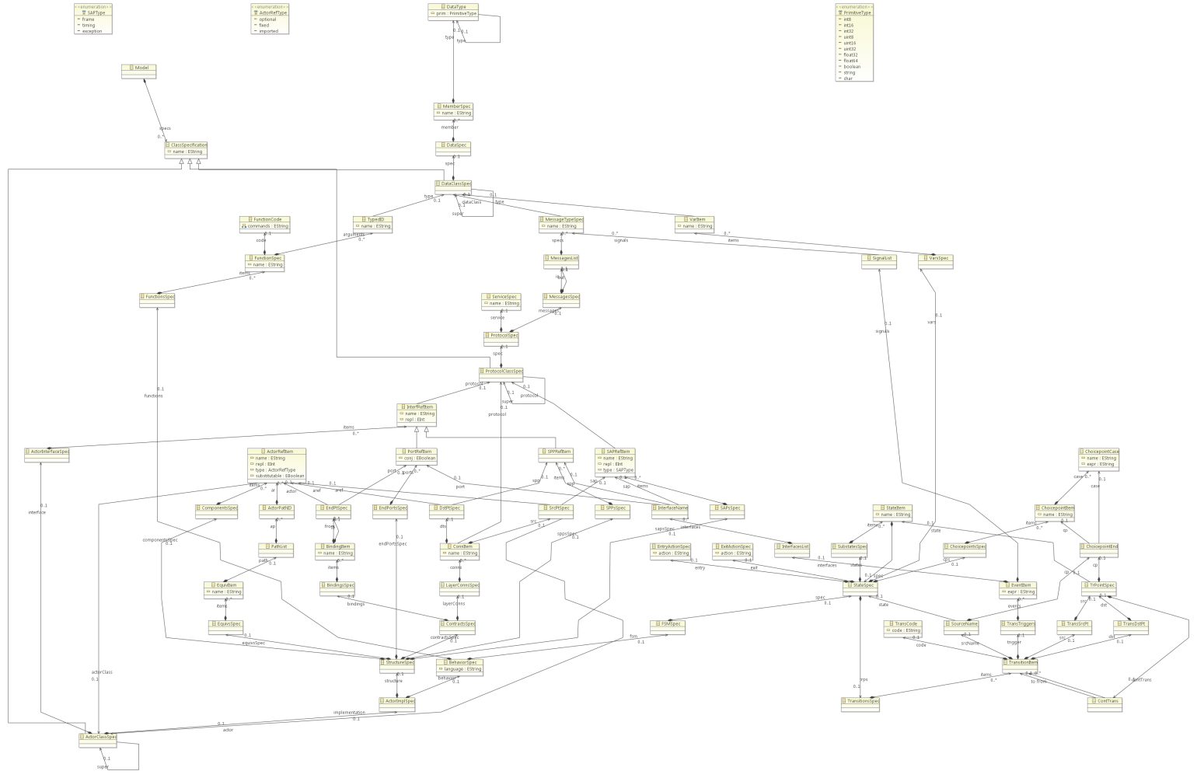
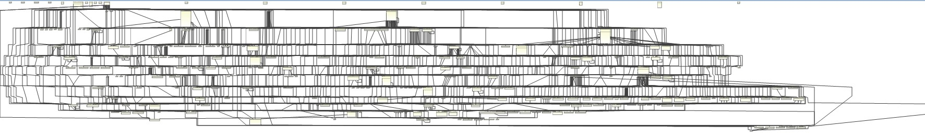
Why ROOM and not UML2?
it‘s all about reduction of complexity !!!
UML2 Meta Model
ROOM Meta Model

Slide 4
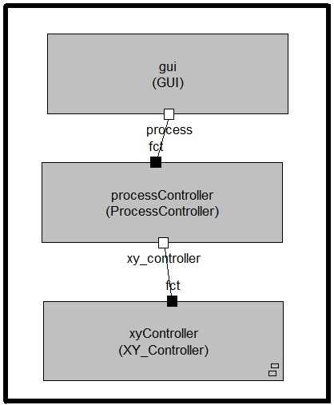
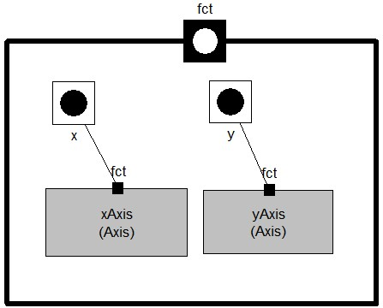
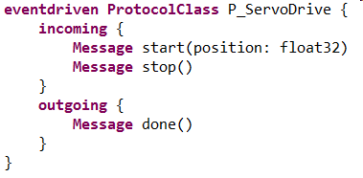
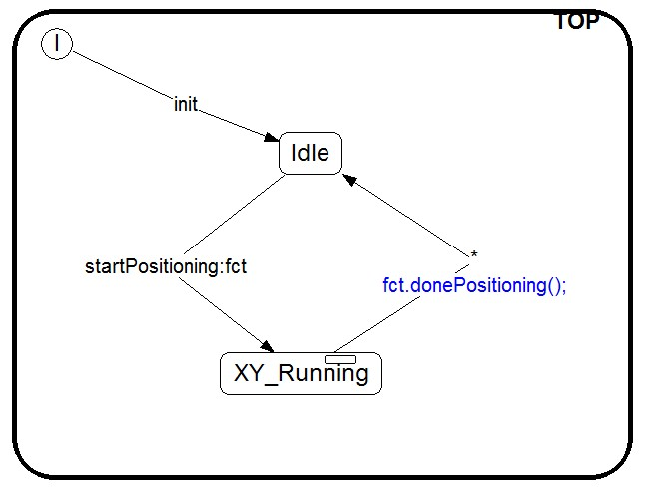
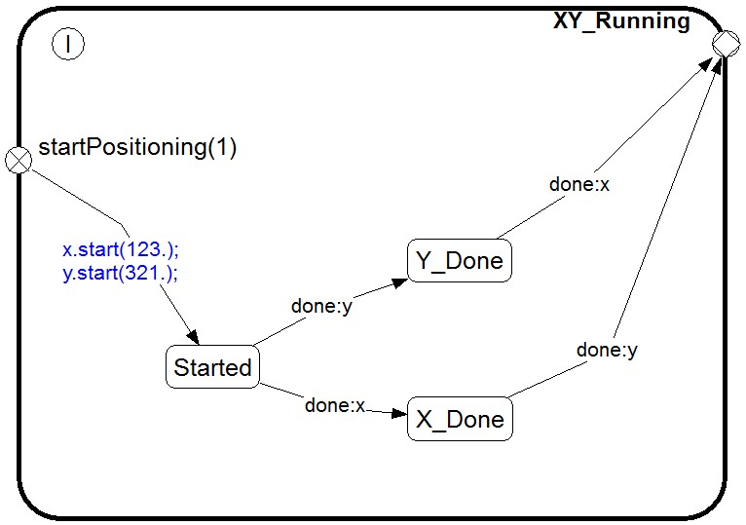
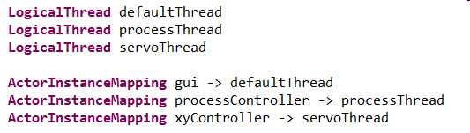
ROOM: Basic Features
Structure Modeling: Hierarchical Actor structures supporting component building
containment
layering
Communication/Interfaces: Protocols and Ports
Behavior Modeling: Hierarchical finite state machines (FSMs) for the event driven behavior
Deployment: Decoupling of Actors by Ports enable free deployment of Actors on Threads and Nodes
Reuse/Variants: Inheritance for Structure, Behavior (FSMs) and Protocols

Slide 5
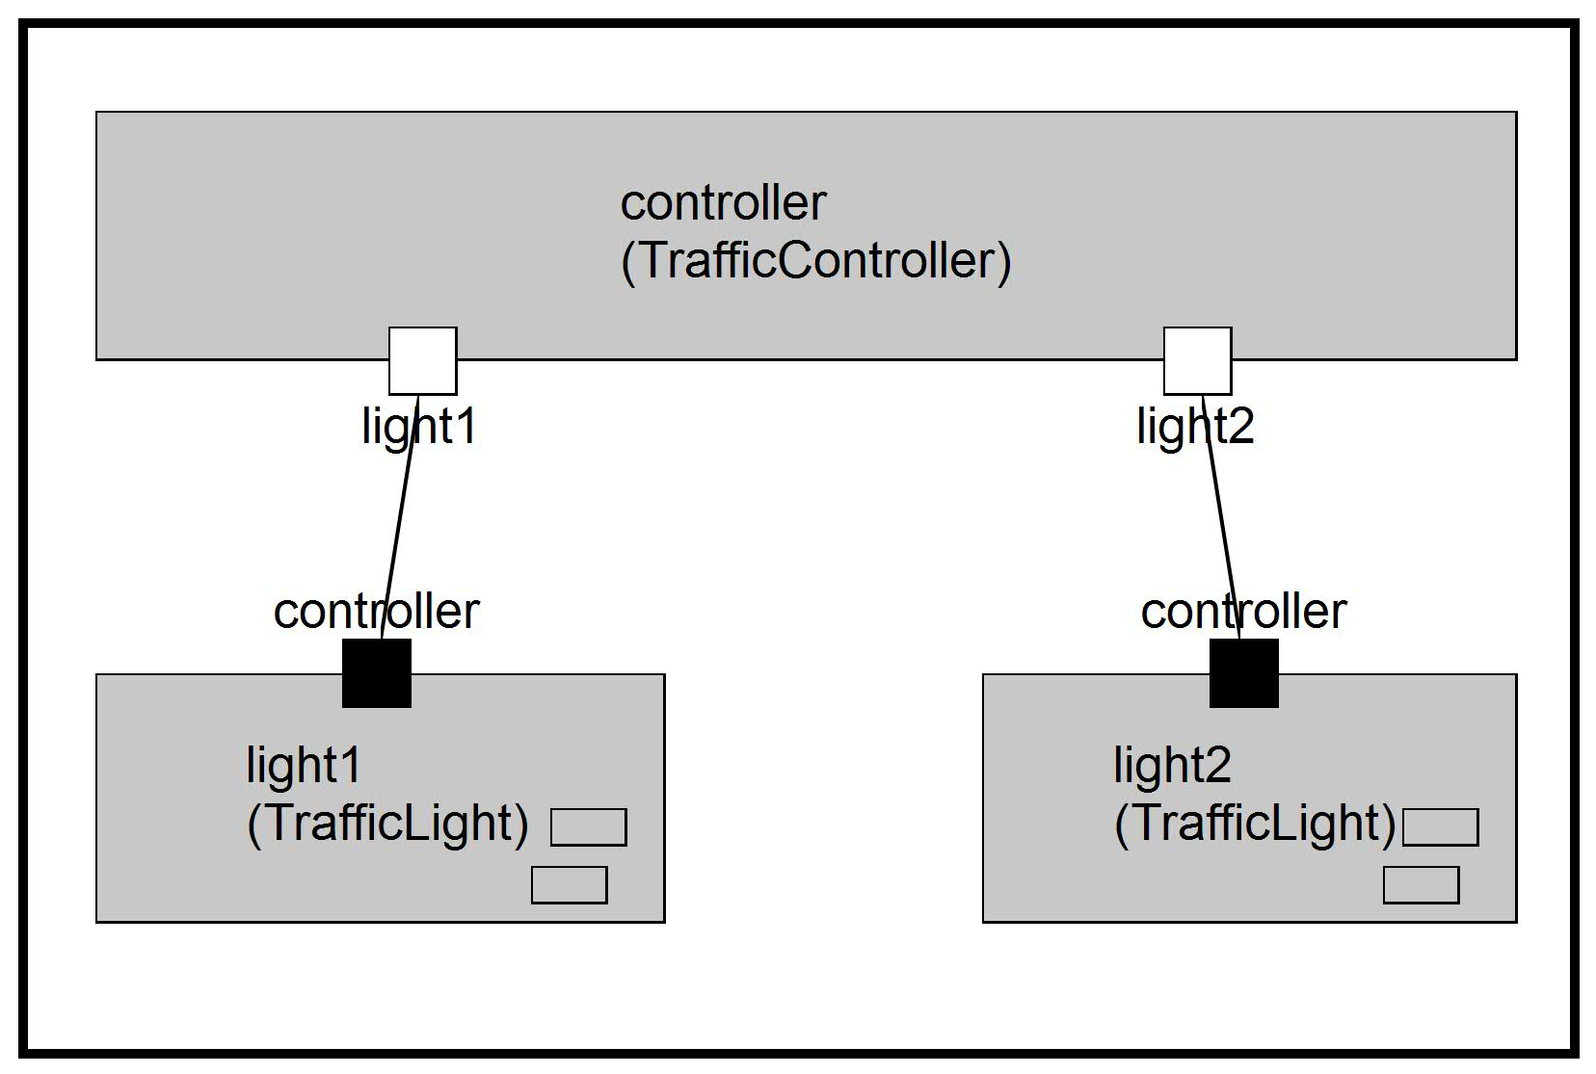
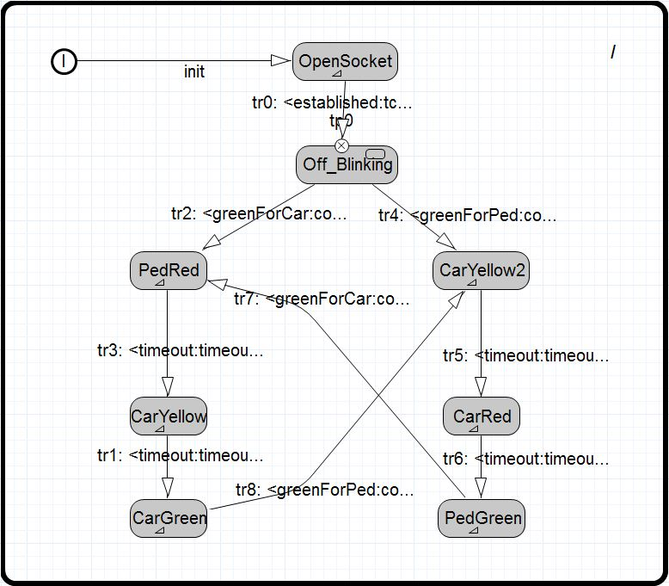
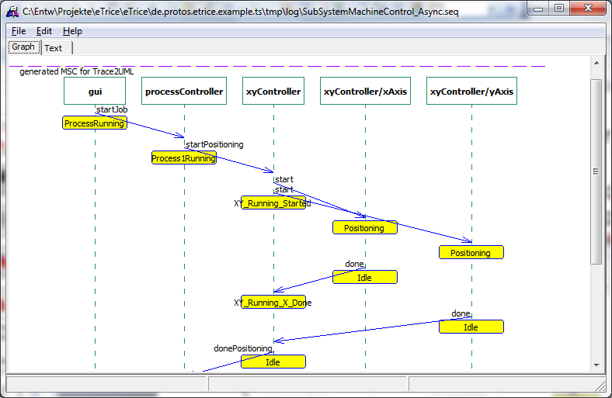
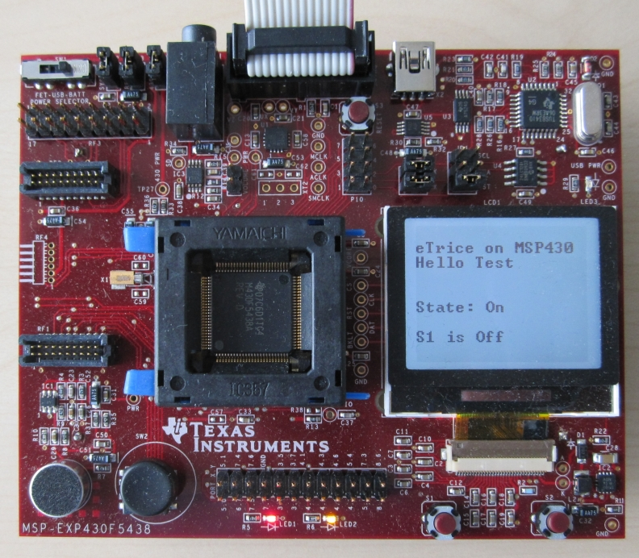

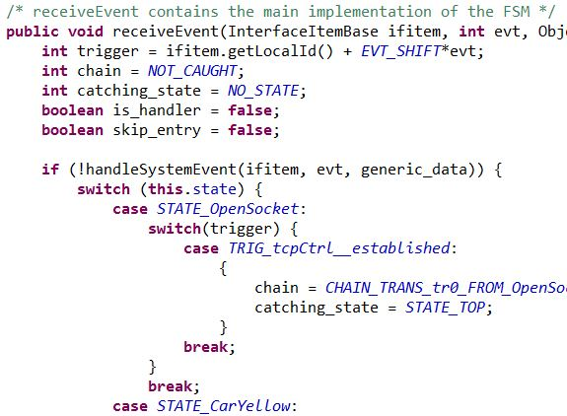
eTrice Toolchain
Structure Model
Behavior Model
generate
debug
+
compile
deploy
Runtime Library
Source Code

Slide 6
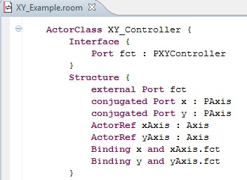
ROOM Editors: Actors & Ports
hierarchical components called Actors define the structure of a system
Graphical Editors
(Graphiti)
Textual Editors
(XText)
Ports are the only Interfaces of an actor and define a specific role in its environment.
Models can be edited with graphical or textual editors

Slide 7
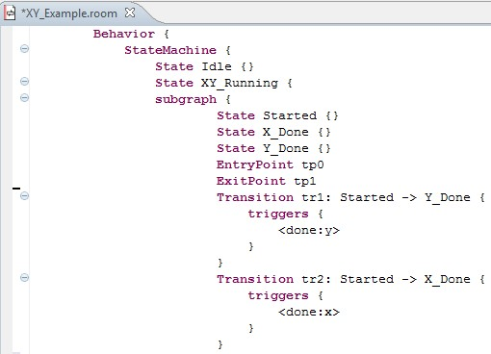
ROOM Editors: Statemachines
hierarchical Statemachines define the dynamical behaviour of Actors

Slide 8
Model Level Debugging: MSC Generator
The events can be logged on the target to create Message Sequence Charts (MSC) of the running application
Logs can be viewed with Trace2UML (http://trace2uml.tigris.org/)

Slide 9
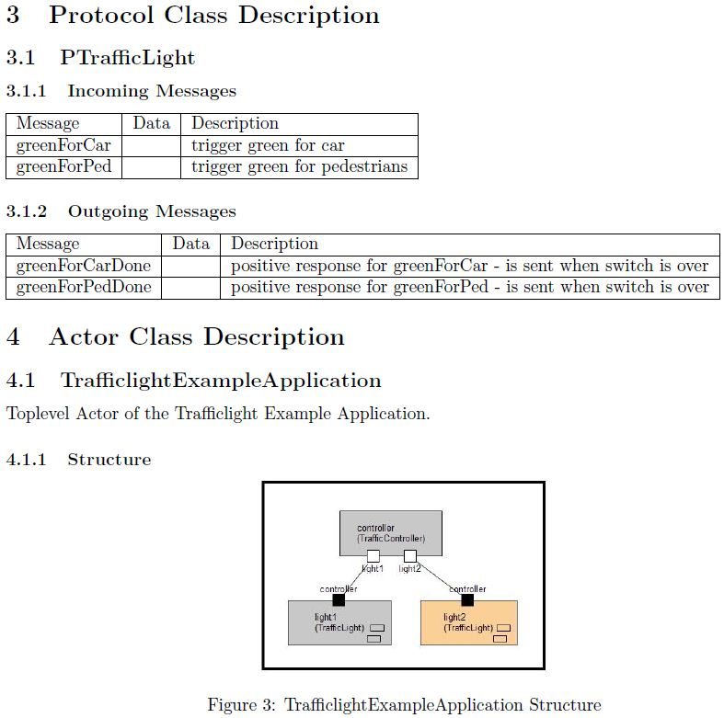
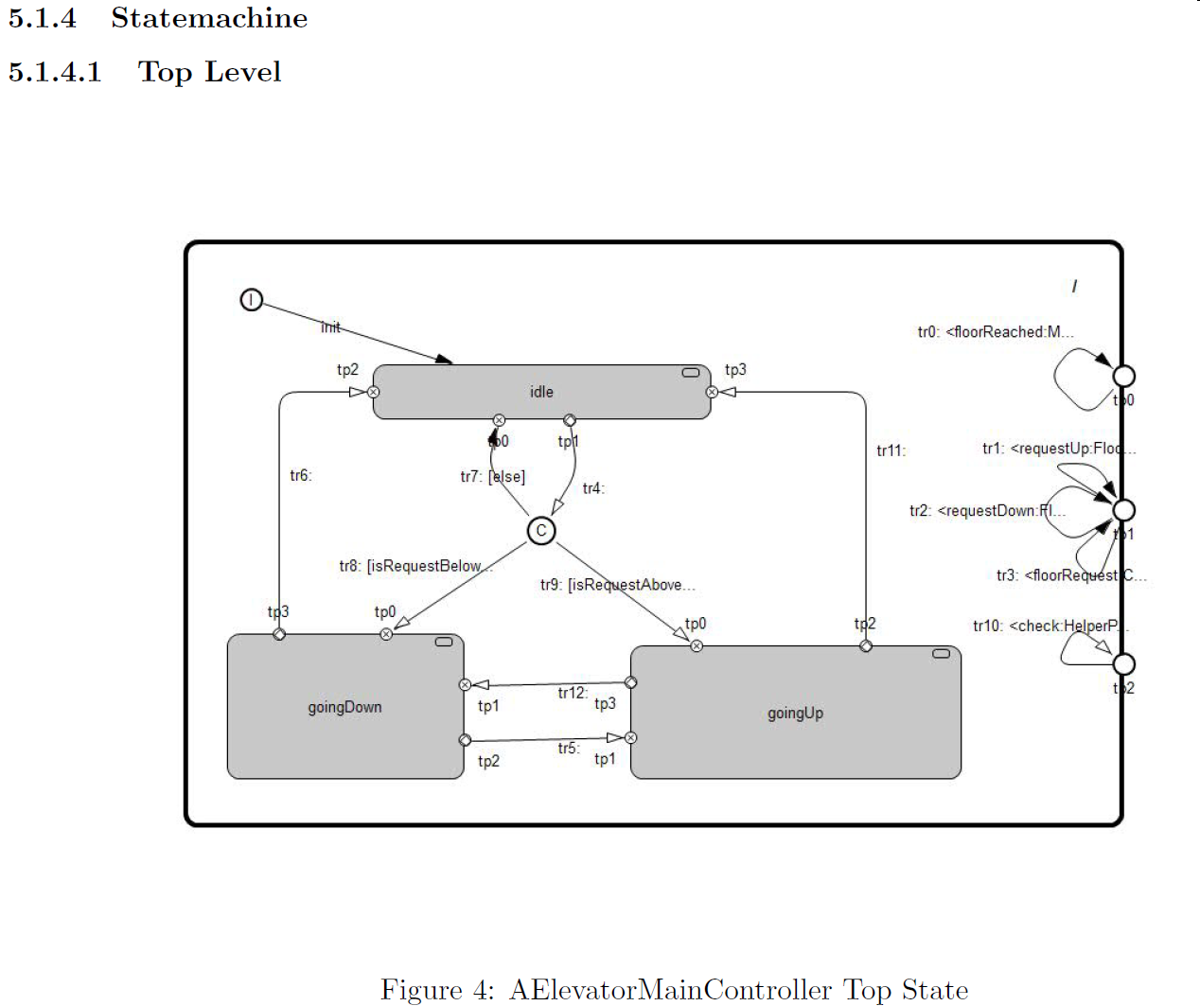
Generated Documentation
Model information can be generated as LaTeX documentation
Manual documents can be integrated
LaTeX documents can be converted into PDF, OpenDoc, Word-Doc, HTML, …

Slide 10
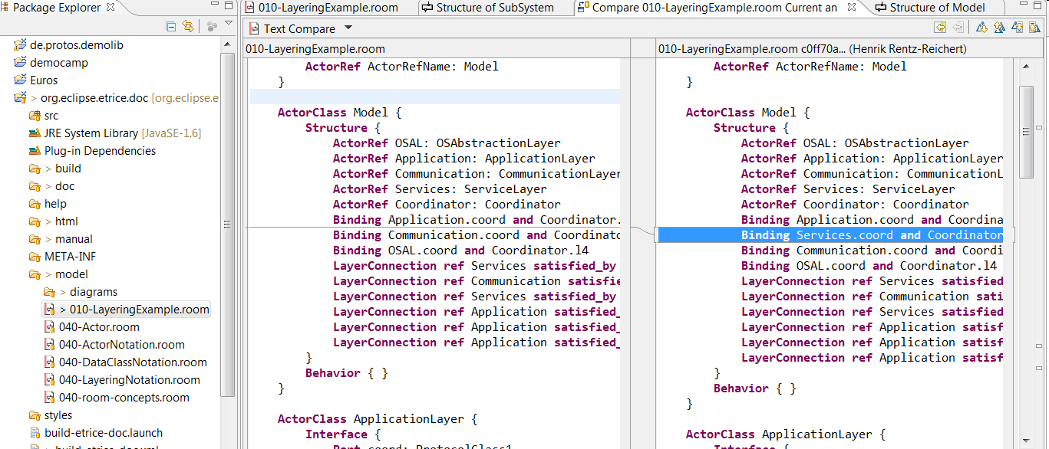
Diff and Merge
Persistency based on Ascii Files enables simple Model Diff and Merge
No special tooling necessary

Slide 11
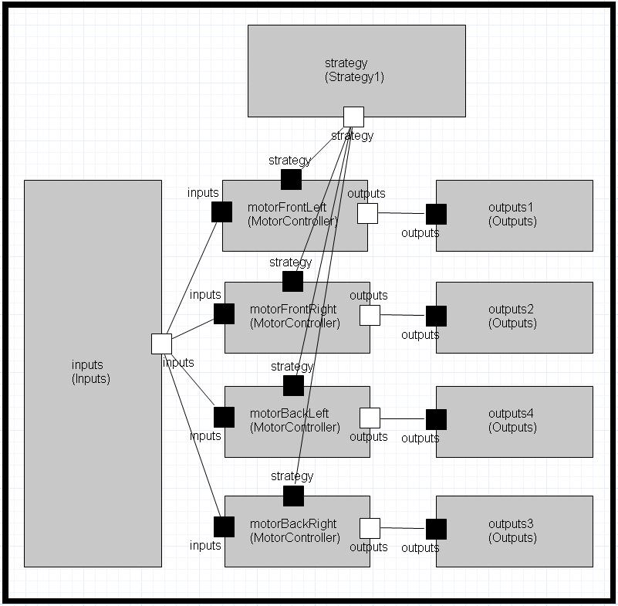
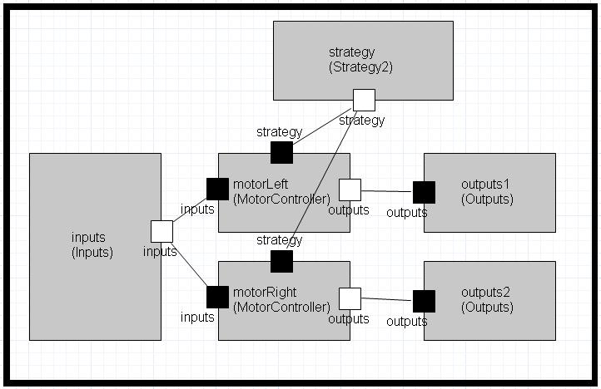
Structure Variants
existing Actors can be combined to different applications
Actors with same Ports can replace each other

Slide 12

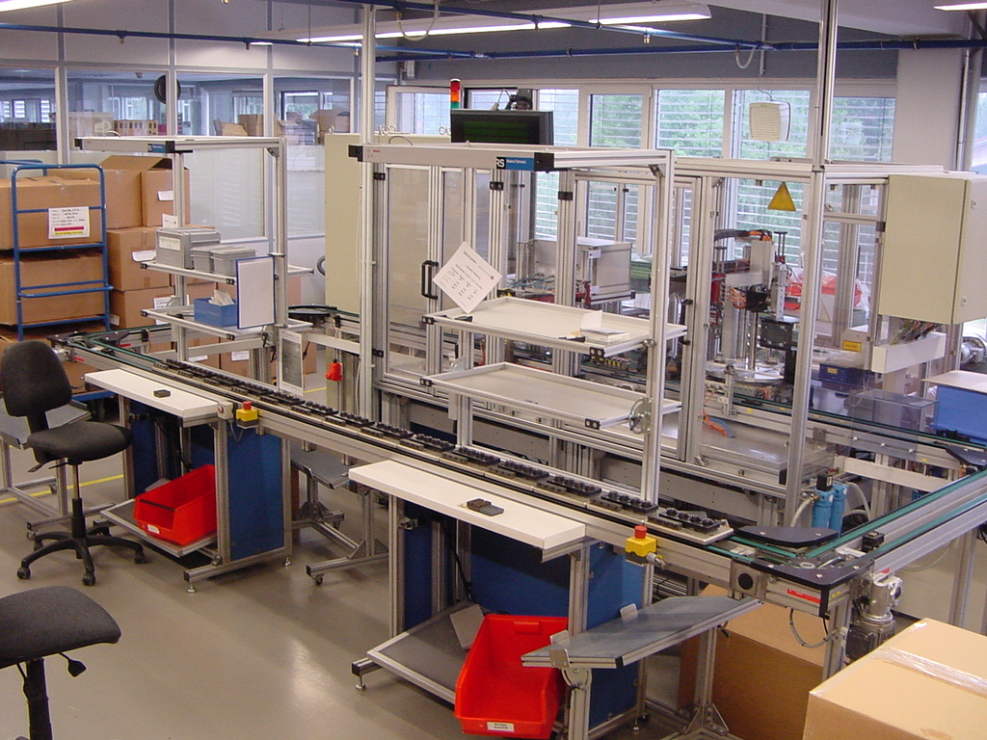
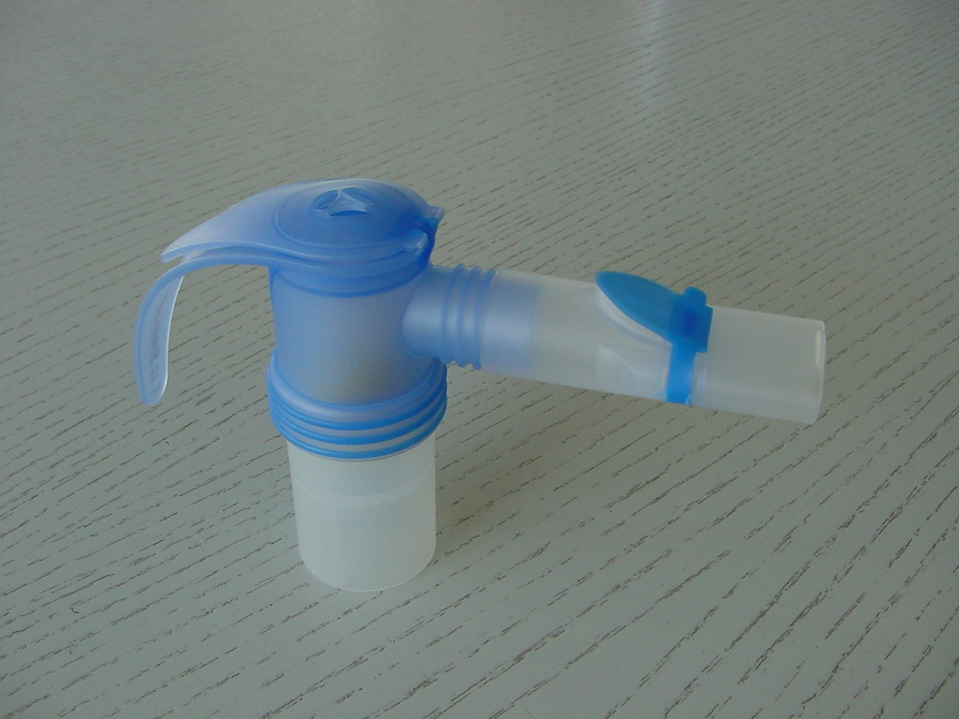
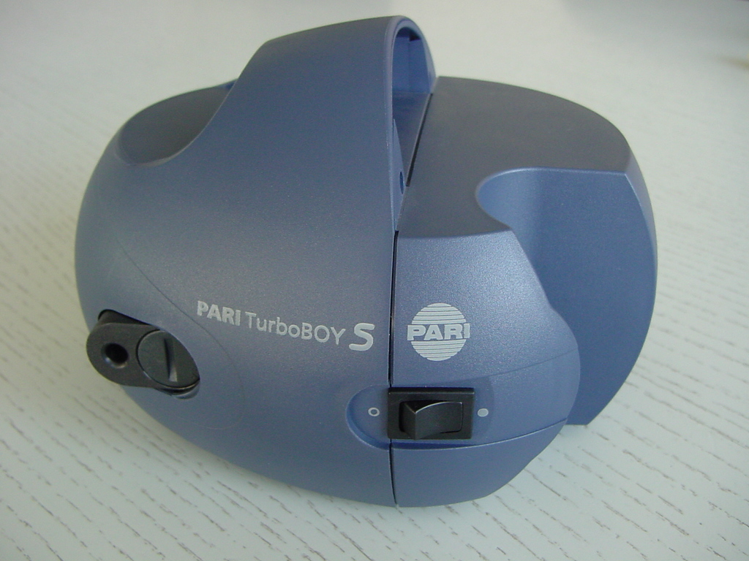
Example: PariTec
Automation Control
1. smaller production system for nebulisers
2. bigger production system for compressors
Notes:
t
12

Slide 13
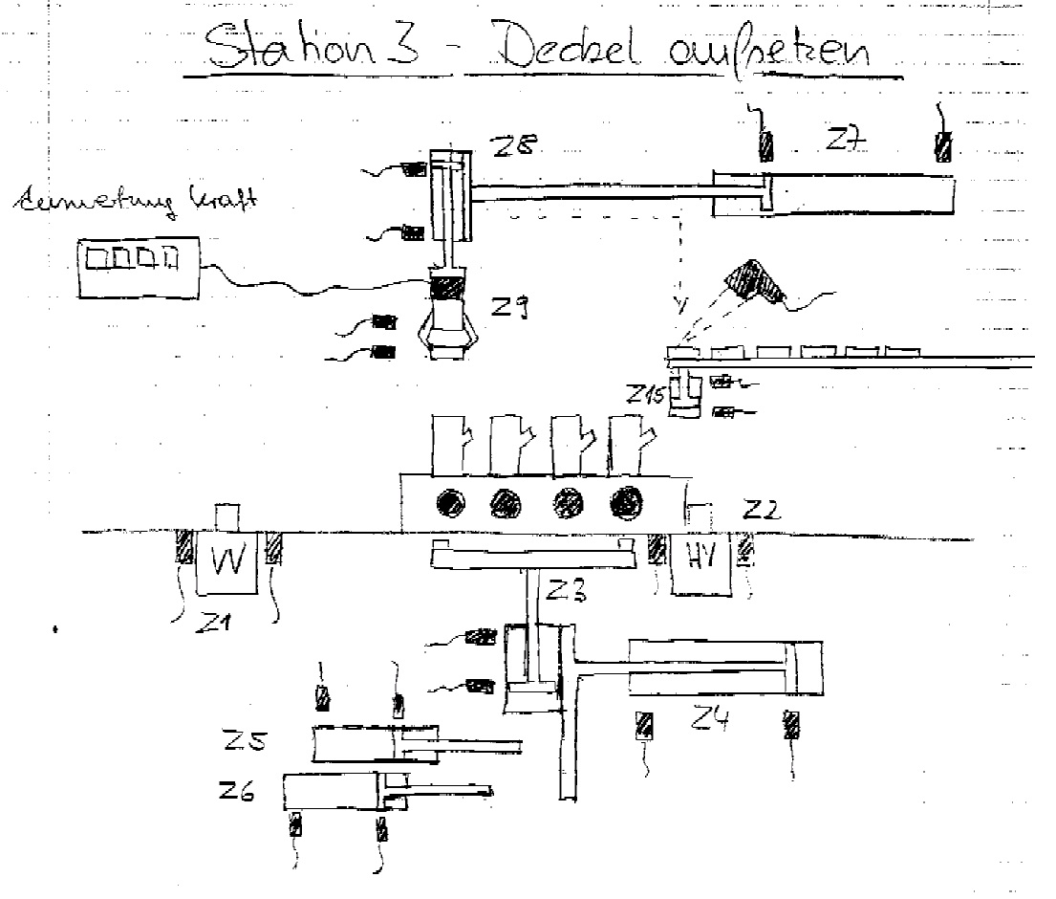
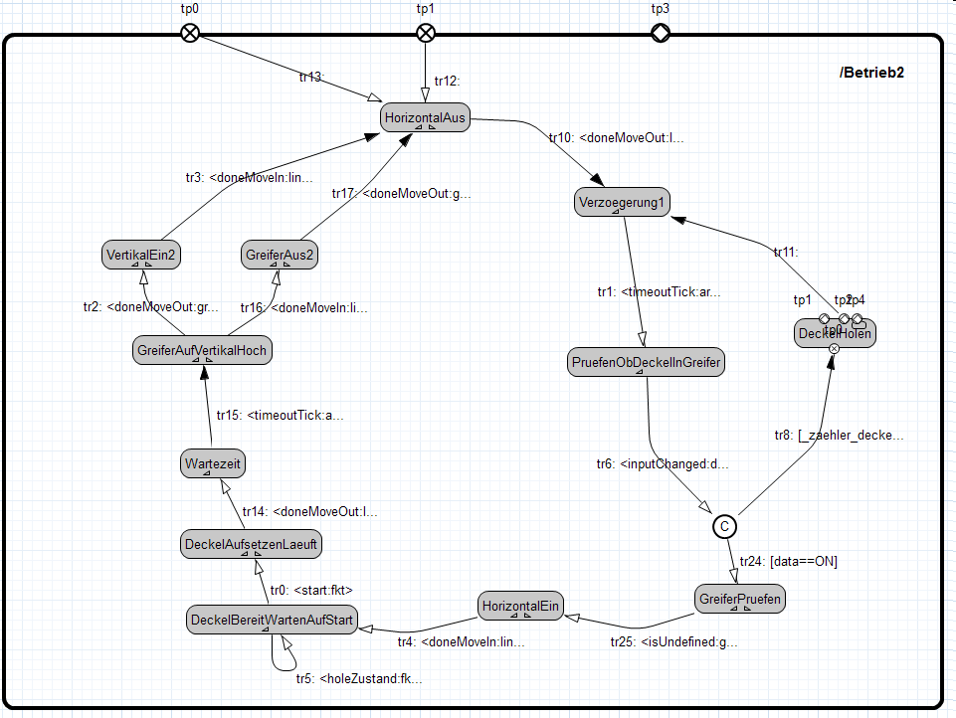
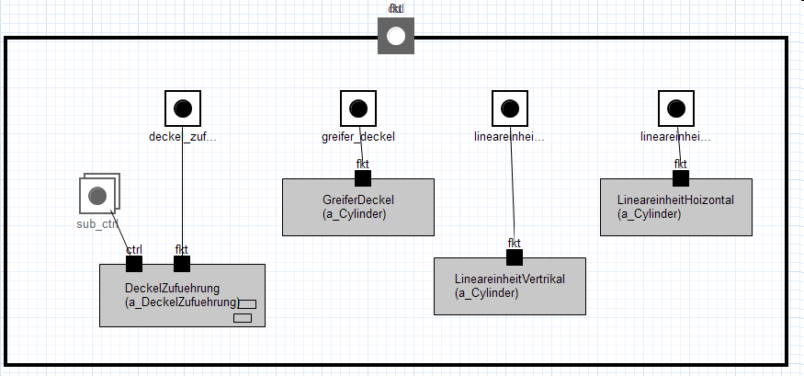
Example: PariTec
From Reality to Model
Behavior
Structure
Notes:
t
13

Slide 14
Eclipse etrice Software Stack
Eclipse Open Source Projects
eTrice
Xtext
Graphiti
Xtend
Eclipse Modeling Framework (EMF)
Eclipse Platform
Notes:
14

Slide 15
Conclusion
etrice is a modeling toolset for eventdriven, concurrent realtime systems
the language ROOM has been specifically designed for eventdriven, concurrent realtime systems (telecommunication)
etrice can be used for various domains
it is simpler than many other tools
it can be easily extended with domain specific language extensions and code generators
etrice is completely Open Source (Eclipse Public License, EPL)

Slide 16
Outlook
Release 0.3 planned for Q3 2013
First prototype of C++ generator
Data configuration model
Integration of GSOC projects:
Detail level (expression) language
Model checking for Statemachines
Layouter for graphical editors
First version of physical- and mapping model (deployment)
Consolidation of current features
Further releases
more model level debugging (state machine back animation, data inspection and manipulation and message injection )
model level support for distributed systems
more detailed documentation generator
Abstract execution for ROOM and expression language
…

Slide 17
... any questions?
Thomas Schütz ts@protos.de
http://www.eclipse.org/etrice
http://www.protos.de

